Slide 1
FYND SSIPL DATA ANALYSIS
Analysis of previous 6 months data and trends study
-by Amogh Dubey

Slide 2
Data Normalisation and Ingestion

Slide 3
Data normalisation and ingestion
The data provided in the format of a csv had a couple of issues and therefore a little difficult to analyse the way it was due to large volume and hence needed cleaning.
To proceed with it, I first created a .csv file with a delimiter as semicolon symbol ( ; ) since the file was using comma ( , ) as the delimiter and the field of address_1 had values which included the comma thus making the data to get ingested incorrectly in the database, causing a loss of data. So I converted the csv back to an excel file and re-exported it in a csv with the new delimiter. [To avoid this situation while creating the raw data assuming it is generated utilising an automated python script or an unload script that extracts the data from an external DB, the delimiter can be modified as ; in the script.]
Secondly the fields l1_category and l3_category had some discrepancies, where some redundant fields in l1_category which should have broadly been classified in the 6 major categories were wrongly classified. Given that these were irregularities I created SQL queries after analysing the data (specific details in later slides) and updated these columns.
After the data was cleansed I proceeded with the analysis of the data.

Slide 4
Sales Data Factual Information (Category-wise)

Slide 5
Footwear
In Footwear section, the l1_category had a total of 2 more discrepancies. It comprised of fields incorrectly marked as [“Footwear”,”Footwear”] and [“Footwear”,”Footwear”,”Footwear”].
Though the ratio of such records was relatively small, but during my normalisation and cleansing I updated their fields as [“Footwear”]
Footwear comprised of the largest section of the sales records as well comprising of 36,839 records of the total 46,436.
In Footwear alone, taking into consideration various filters like returned, lost in transit, defective products etc. the total sales for the seller are of 2,81,87,617.2978 rupees of the total sales records of Footwear of 4,41,87,824.5477 rupees.
In terms of popularity within the Footwear category, Indoor Sports Shoes are the most popular followed by Sneakers.

Slide 6
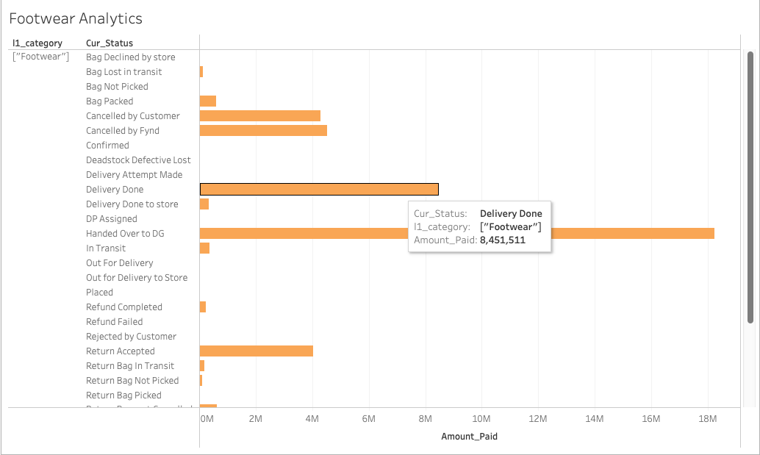
Footwear
As per the Current Status of the items in Footwear section the most items belong in the Handed over to DG and Delivery Done section but a significant portion of the items seem to be returned/ defective/ lost in transit/ etc.
One step in increasing the sales would be trying to reduce the cancellations by providing more incentives in forms of sales, discounts, offers and heavier marketing since this is the most popular section

Slide 7
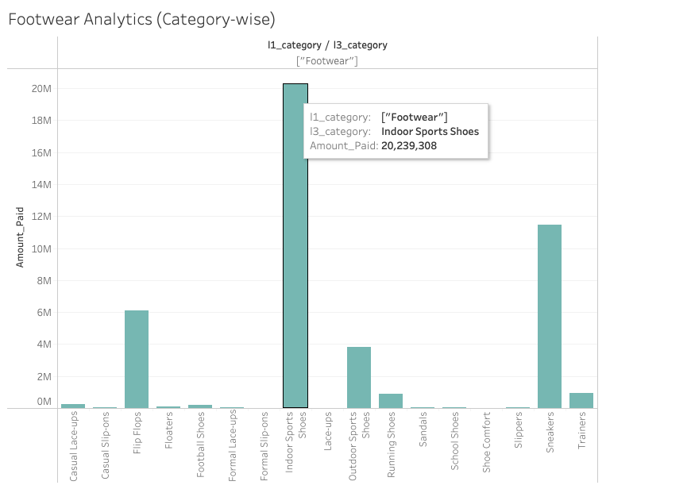
Footwear
In terms of the subcategories in Footwear aka l3_category, the most popular is Indoor Sports Shoes.
Given that this subcategory is the highest contributor in the biggest category of sales records, other categories like Flip-Flops, Sneakers and Outdoor Sports Shoes can be promoted as well along with Indoor Sports Shoes with additional benefits/ discounts on these categories to promote their sales since they are the major contributors after the biggest subcategory.
For the smaller subcategories more variety and options being introduced may increase the sales, so they can be focused on depending upon inventory size and brands available.

Slide 8
Clothing
Clothing is the second biggest category in terms of records. It has a total of 58,18,239.5194 rupees
Of this category, the sales in terms of Delivered and Handed over to DG are again the biggest contributors in terms of current status, contributing 35,48,914.049 rupees
Total record contribution in the past 6 months in terms of sales are of 5790 records. Considering Clothing is a big market in terms of e-commerce it’s relatively smaller and therefore the seller can focus more on Clothing since this category is bound to produce more sales since it is a big player.
In terms of popularity within the sub-categories T-shirts are the most popular followed by Activewear Joggers.
In Clothing section there were discrepancies as well which included some instance of records being classified as [“Clothing”,”Clothing”]. These instances were rectified via a simple sql query to update those columns and SET value as only [“Clothing”].

Slide 9
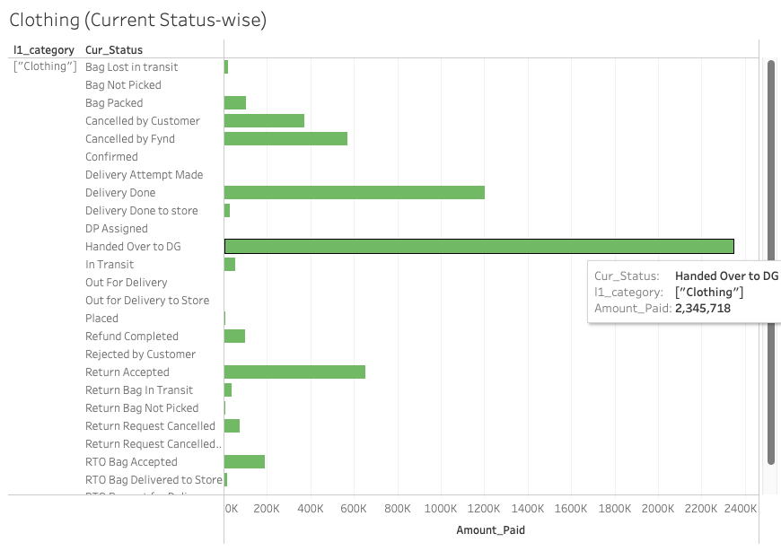
Clothing
Clothing in terms of total sales and current status of those sales has similar trends like Footwear. Most entries belong in the Delivered and Handed over to DG. But a decent portion of those also belong to defective products/cancelled by customer/cancelled by Fynd.
Similar to Footwear, more prominent advertising of Clothing in general with attractive deals, offers and discounts would go long ways in increasing the sales.
More focus on reduction of inadvertent losses due to defects/incompetent prices/ other factors would help boom this category since it is one of the biggest players in terms of e-commerce sales

Slide 10
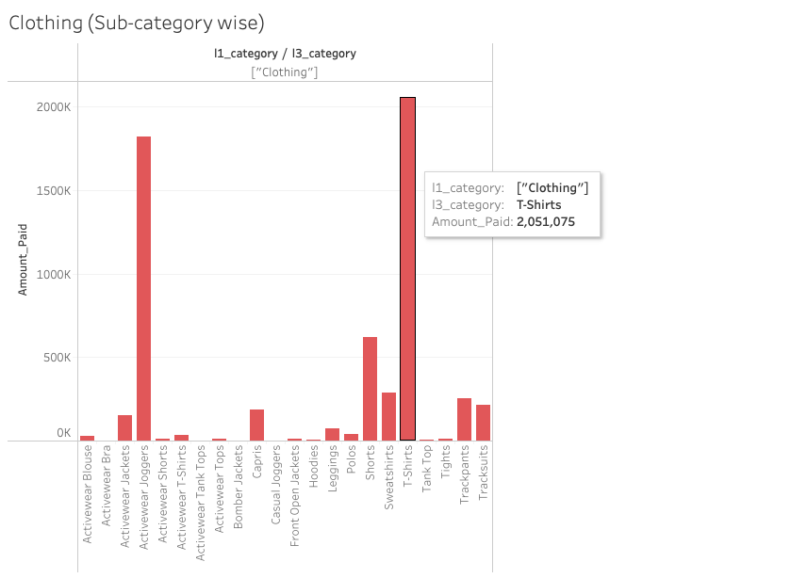
Clothing
As seen in the sales in regards to subcategories, T-shirts seem to be the clear winner followed by Activewear Joggers.
T-shirts have a total sale of 20,51,075 rupees considering all the records.
Clothing being a major player in terms of e-commerce is a great investment as long as products are high-quality and prices are competent, therefore increasing stock of the same and providing more variety (starting off with more popular subcategories) would prove to be beneficial.

Slide 11
Accessories
The third largest category in the records of the sales, Accessories have a total sale of 22,17,724.130 rupees.
Out of these sales records, the highest component is again comprised of Handed over to DG but unlike the previous two categories, Cancelled by Fynd has a higher ratio than Delivery Done component.
Accessories overall have a rather small ratio in comparison to the previous two categories with a total of just 2919 records.
In the prospect of the subcategories Socks, Cravets, Backpacks and Activewear Accessories have the biggest contribution in Accessory sales.

Slide 12
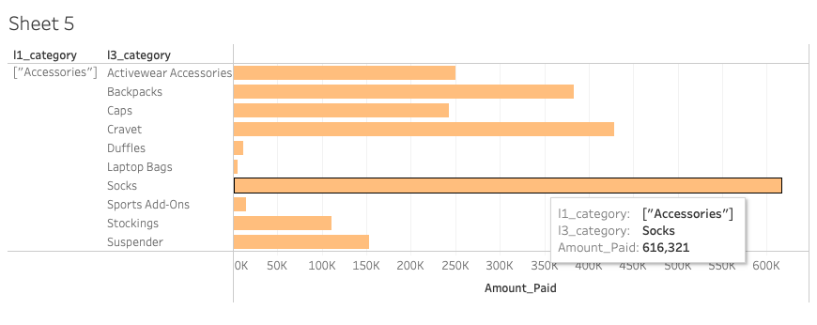
Accessories
Accessories seem to be relatively smaller in comparison to the other two categories and hence have a smaller contribution in the sales.
Given that in terms of sales the major component comes from subcategories that are Socks and Activewear Accessories so a trend in the data shows more inclination of customers buying sportswear and fitness related products as noticed in the categories of Clothing as well as Footwear.

Slide 13
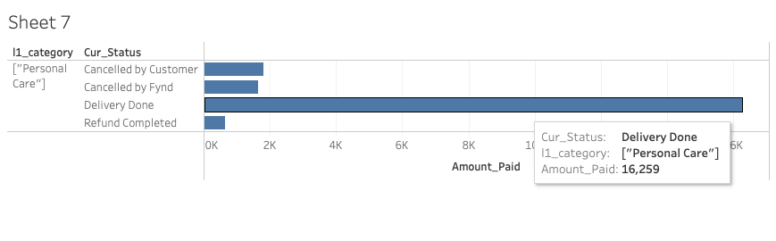
Personal Care
Personal care products comprise of a very small ratio of sales in the seller’s total sales records with there being only 84 such records.
Net sales of the Personal Care products is worth 20,363.699 rupees only and have one subcategory which is only Protective Masks.
Personal Care products have a very high delivery rate surprisingly, in comparison to the other categories, with 16,259 rupees coming from successful deliveries.

Slide 14
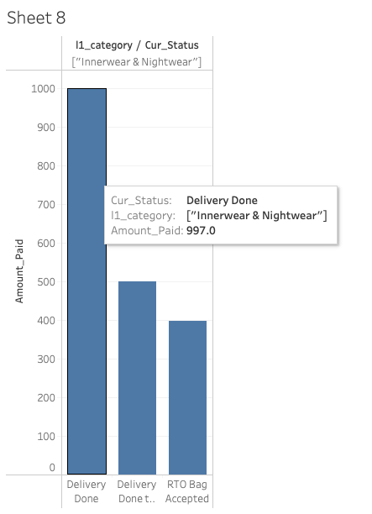
Innerwear & Nightwear
Innerwear and Nightwear is the smallest category of the sales with only 5 total records, but has no defects/delivery issues/cancellations.
The total sales for this category is only worth 1894 rupees.

Slide 15
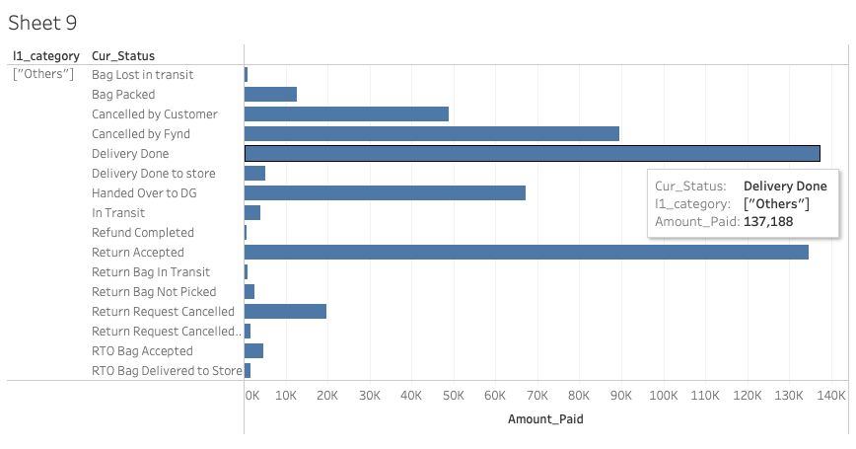
Others
This section comprises of sales for records which aren’t categorised in any other major category.
The total sales from this section is decently higher in comparison to the smaller categories with a net sales of 5,32,177.5 rupees.
This category doesn’t have any sub-classifications and surprisingly holds an almost equal amount of refunds and delivered correctly items, therefore the net profits not being very high.

Slide 16
Data based on demographics

Slide 17
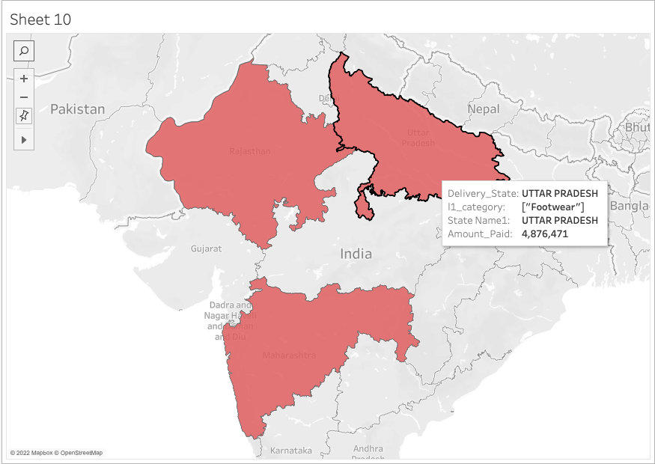
In terms of Footwear, the biggest consumers of products are the states of Uttar Pradesh, Maharashtra and Rajasthan. So for targeted increase of sales, these three states can be the top most priority for Footwear which is the biggest contributor of sales.

Slide 18
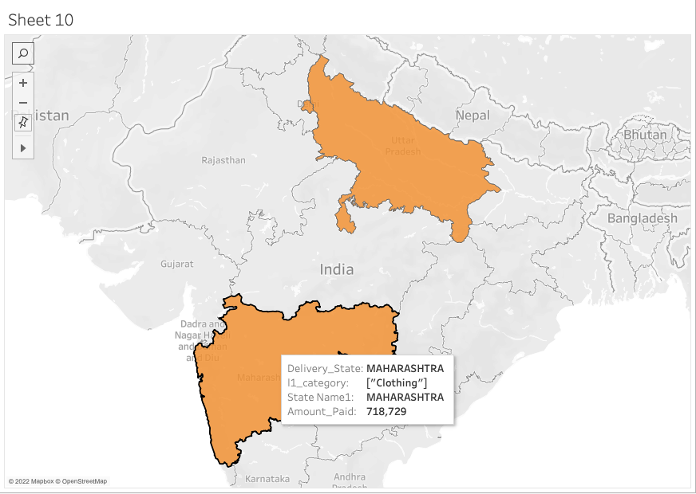
In terms of Clothing, which is the second biggest contributor with regards to sales, Maharashtra, Uttar Pradesh and Delhi are the biggest consumers. So again two of three states are common for the two biggest sales sections and thus set up of more stores, more variety of products and more quality deliveries will vastly improve the sales.

Slide 19
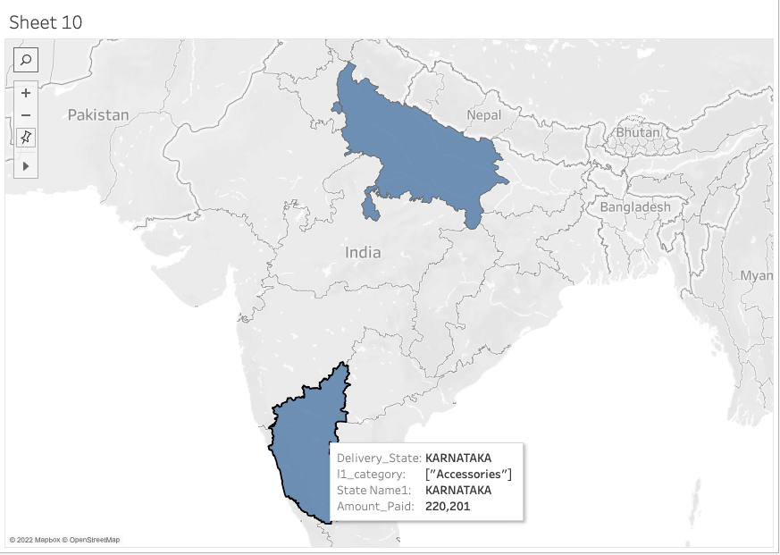
Moving to the third category of Accessories, the states of Karnataka, Uttar Pradesh and Delhi take the leads. Again two of the three states clash with Clothing as well, with the states of Delhi and Karnataka being the odd ones out. Yet since both of these states are neighbours to Uttar Pradesh and Maharashtra along with Rajasthan as well, more stores and plethora of items available in these categories for these two belts will probably be more future-proof for the seller.

Slide 20
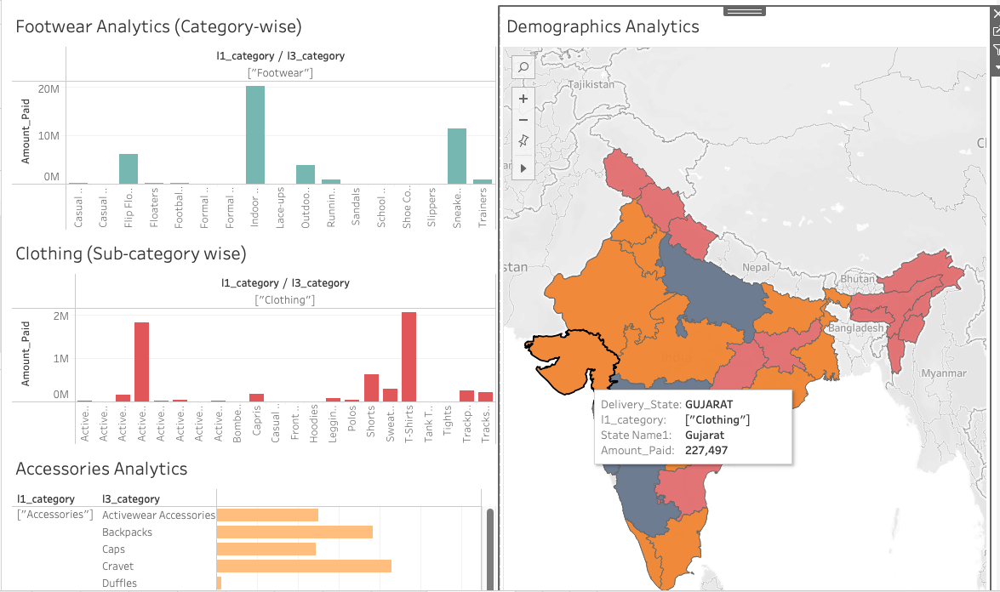
A complete view of the Dashboard in Tableau

Slide 21
Final Thoughts
Given the sales records of the seller, some trends become visible as per the numbers which elucidate a certain pattern of customers.
The customers are more inclined towards fitness wear and sports gear, given that those components are major sub-category contributors in the big three categories namely Footwear, Clothing and Accessories.
The sales numbers are decent but in the big three the major sales profits are 63.8% (Footwear), 60.99% (Clothing) and 71% (Accessories) considering the Current_statuses of Delivered correctly and Handed over to DG are taken into consideration. A target of atleast 80-85% should be achieved in the big three at the very least as a start plan for increase in sales via reduction of defective products through appropriate inspection checks, orderly deliveries with as minimum as possible in transit/delivery losses and reduction in order cancellations by providing deals worth stealing.
As noticed via the demographics as well the belt of Delhi, Uttar Pradesh, Rajasthan and Karnataka, Maharashtra have some of the highest number of consumers and spenders. Therefore setup of more stores(delivery centres) in these two belts with appropriate stocks of items should help make the big three categories gain more sales.
Lastly Clothing is relatively a smaller ratio compared to Footwear in the sales but in e-commerce it is one of the hottest markets, therefore some stock increase of clothing items (especially those most in demand like the T-shirts section and Activewear) can help provide an insight on whether the sales see a rise. It could help increase the net revenues as the category grows and also provide opportunity for other categories like accessories and innerwear to get more stocks and grow over time.

Slide 22
Methodologies
Some ideas and methodologies used for the analysis deployed by me during the analysis include
S-pecific: whether the answers have specificity
M-easurable: are the conclusions measurable
A-ction oriented: do the answers help devise a plan
R-elevant: is the question relevant
T-ime bound: are the answers relevant to the specific time
During the analysis some other anomalies were also observed by me in the dataset like the States having various iterations for eg:- Odisha and Orissa both being present in the dataset. Since the values of those sets were relatively small, hence I overlooked them but in a more exhaustive dataset which would include historical data of many years, a normalisation for every attribute which can have pre-defined set of answers needs to be applied to cleanse the data.
Along with this, considering the data has a couple of attributes which are blank, they can be omitted since they do not affect the main Ask for the analysis which is methods to improve sales.
The analysis is completely unbiased, since I have no connections with SSIPL. Therefore the analysis done is free from any bias in accordance with the ideology that any bias can create erroneous information.

Slide 23
Tools utilised
SQL Workbench
Tableau
Excel
Open Source Excels (for visualization of maps)
Python

